Slide 1
CCE201: Solid State Electronic Devices
EEC223: Electronics (1)
Lecture 01: Introduction
Prepared By
Dr. Eng. Sherif Hekal
Assistant Professor, CCE department

Slide 2
Course Information 1
Course Name: Solid State Electronic Devices
Course Code: CCE201
Course Materials are on my website:
http://www.bu.edu.eg/staff/sherifsalah3

Slide 3
Course Information 2
Course Name: Electronics (1)
Course Code: EEC223
Course Materials are on my website:
http://www.bu.edu.eg/staff/sherifsalah3

Slide 4
Teaching staff
Lecturers | Prof. Hala Abdel-Kader Assistant Prof. Sherif Hekal
Teaching Assistant | Eng. Ahmed Samir

Slide 5
Contact me
Dr. Sherif Hekal
Room number : SB5-05
Email address:
Sherif.salah@feng.bu.edu.eg

Slide 6
My rules
No eating
No drinking
Silence except for asking questions
Shutdown your Mobile, Tablet, etc. and put in your pocket.

Slide 7
Course meeting time & Location
 |  | Number / week | Day | Time | Location
Contact hours | lectures | 2 h | Saturday | 09:00-11:00 | Room ??
 | tutorial | 2 h | Saturday | 11:00-13:00 | Room ??
 | Lab* | 3 h | Tuesday | 13:00-16:00 | Electronics Lab
* Lab times are only for the students of Electronics (1) course

Slide 8
CCE201: Course Info
Course Title | Solid State Electronic Devices
Course Code | CCE201
Credit Hours | 3
Contact Hours | Lecture | 2 | Tutorials | 2 | Lab. | -
Prerequisite(s) | EMP104
Topics | Basics of semiconductor physics – Fermi-Dirac distribution – Carriers concentrations – Intrinsic and Extrinsic materials – Charge neutrality – Currents in Semiconductors (drift current – diffusion current) – Semiconductor parameters (mobility, Scattering, lifetime) – Hall effect. – PN junction theory – Diode IV characteristics – large and small analysis – Analog and digital diode applications (Rectifiers, Clipping circuits, Clamping Circuits, multipliers) – Special purpose diodes (Light emitting diodes, photo diodes, Zener diode and its applications)– Basics of Bipolar junction transistors (BJT) and field effect transistors (FET) – physical operations, characteristics, specifications.

Slide 9
EEC223: Course Info
Course Title | Electronics (1)
Course code | EEC223
Credit hours | 4
Contact Hours | Lectures | 2 | Tutorials | 2 | Lab. | 3
Prerequisites | EEC211
Topics | Semiconductors, p-n junction, diode current components, junction capacitance, junction diode as a circuit element, special p-n junctions, bipolar junction transistor and field effect transistor, Thyristors.

Slide 10
Course Assessment
Assessment Type | Percentage | Time
Midterm1 | 30% | Week 07
Midterm2 | 20% | Week 12
Attendance, Assignments | 10%
Final Exam | 40% | Week 16
Total mark | 100%
Conditions of the success are:
1- getting 60% of the total mark.
2- getting at least 30% of the full mark of the final exam.

Slide 11
Course Assessment
Percentage | Grade | Points
Score ≥ 97% | A+ | 4
93% ≤ Score < 97% | A | 4
89% ≤ Score < 93% | A- | 3.7
84% ≤ Score < 89% | B+ | 3.3
80% ≤ Score < 84% | B | 3
76% ≤ Score < 80% | B- | 2.7
73% ≤ Score < 76% | C+ | 2.3
70% ≤ Score < 73% | C | 2
67% ≤ Score < 70% | C- | 1.7
64% ≤ Score < 67% | D+ | 1.3
60% ≤ Score < 64% | D | 1
Score < 60% | F | 0

Slide 12
Syllabus
Weeks | Topics
1 | Introduction
2 | Basics of semiconductor physics
3 | Intrinsic & Extrinsic semiconductors
4 | Carrier Transfer
5 | PN-junction
6 | PN-diodes and their applications
7 | Midterm 1
8 | Special purpose diodes
9 | Bipolar junction transistor (BJT) I
10 | Bipolar junction transistor (BJT) II
11 | Bipolar junction transistor (BJT) III
12 | Midterm 2
13 | FET transistor I
14 | FET transistor II
15 | Thyristors

Slide 13
Syllabus
Text Book S. M. Sze (2001). Semiconductor Devices: Physics and Technology, Wiley & So., ISBN 0471333727.
Recommended references supporting the course
B. Streetman, S. Banerjee (1999).Solid State Electronic Devices, Prentice Hall, ISBN 0130255386. Robert L. Boylestad, Louis Nashelsky, (2013) Electronic devices and circuit theory, 11th edition, Pearson Education Neamen D.A., (2007), Microelectronics Circuit Analysis and Design, McGraw Hill.

Slide 14
Simulators
Proteus
OrCAD
SPICE
Online simulator
http://www.falstad.com/circuit/index.html

Slide 15
ILOS
Theory
Analysis
Simulation
Implementation

Slide 16
ILOS
Upon successful completion of the course, students will be able to:
Acquire some understanding in the fundamental electric and electronics principles.
Describe the operation and i-v characteristics of diodes and transistors.
Solve basic problems in electronic circuits.
Implement different applications using basic electronic devices (diodes and transistors).
Read and understand the datasheets of diodes and transistors to use the suitable parts in design.
Design and analyze electronic circuits use computer packages (simulators).
Acquire better skills in performing the laboratory experiments.
Work as a team in laboratory sessions.

Slide 17
Course Objectives
Identify and describe operation of semiconductor devices through understanding of the semiconductor physics.
Develop an understanding of the PN junction diode and its behavior.
Develop an ability to analyze diode circuits and examine additional applications of the diode.
Develop an understanding of the Bipolar Junction Transistor (BJT) and its operation.
Identify and describe the different BJT configurations, DC biasing, and AC analysis.
Develop an understanding of the Field Effect Transistor (FET) and its operation.
Identify and describe the different FET configurations, DC biasing, and AC analysis.
Develop an ability to analyze and design BJT and FET circuits.

Slide 18
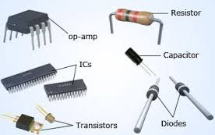
Course Objectives

Slide 19
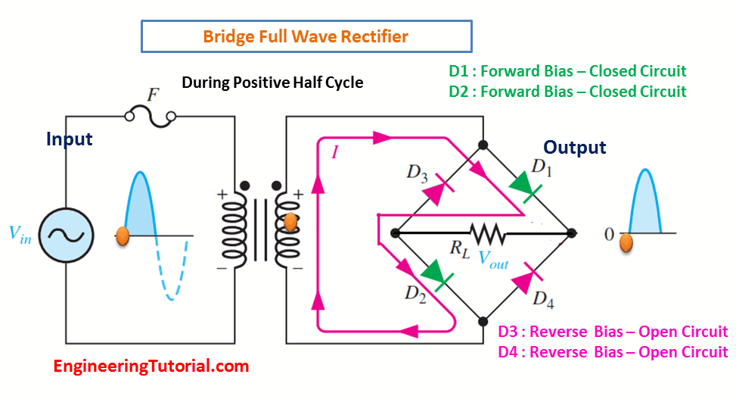
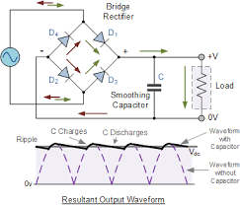
Course Objectives

Slide 20
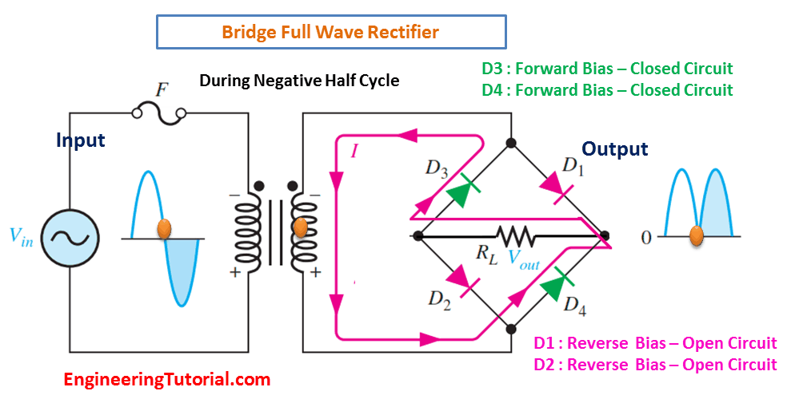
Course Objectives

Slide 21
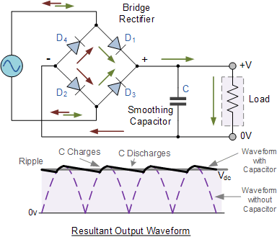
Course Objectives

Slide 22
Example of Questions
State two (2) differences between FET and BJT – LEVEL 1
Explain how depletion region is created in a pn junction? – LEVEL 2

Slide 23
Example of Questions
Sketch the output voltage, V_{O} if the input signal, V_{i} is a 12 V peak-to-peak square wave – LEVEL 3
Analyze the circuit below to calculate the base, collector and emitter currents – LEVEL 4

Slide 24
Example of Questions
Compare the two characteristics for a conventional pn-junction diode and a Zener diode – LEVEL 4/5
Evaluate the circuit below to determine whether the BJT is in cut-off, active or saturation mode – LEVEL 5

Slide 25
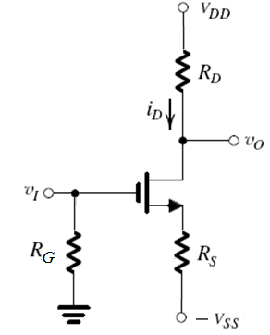
Example of Questions
Design an n-channel MOSFET circuit is as shown in the figure - LEVEL 6
NOTE:
A DESIGN question generally means that you are required to calculate the values of the resistors.

